Slide 1
The Recession, the Housing Market Bubble and Crash, and How We Got Where We Are.
Douglas Campbell
Department of Economics
Fogelman College of Business and Economics
The University of Memphis
December 2010

Slide 2
Recession of 2007-2009
December 2007 to June 2009 (18 months)
Real GDP fell by 4.14%, roughly $550 billion
Around 8.5 million jobs lost
Unemployment rose from 5.0% (12/2007) to 10.1% (10/2009)
Housing prices fell by roughly 25%, more in some areas

Slide 3
By Comparison
The 2007-2009 recession was the worst since …
  The recession of 1945, in terms of lost output. In the 1945 recession, output declined by 12.7%.
  The recession of 1981-1982, in terms of peak unemployment. In that recession, unemployment peaked at 10.8% (11/1982).
  The recession of 1973-1975, in terms of duration. That recession last for 16 months.
  The Great Depression, in the sense that both were caused by financial market crises. No recession since the 1930s, including the most recent, really compares to the Great Depression, at least in terms of magnitude; between 1929 and 1933, output declined by 26.7%, unemployment peaked at 24.9%, and it lasted 4 years and one month.

Slide 4
So What Happened?
Simultaneous credit bubble and housing bubble
Twin bubbles peaked around mid-2006
Housing bubble had its roots in the 1990s
Housing bubble accelerated in 2004
Credit bubble fueled the housing bubble
Once the bubbles popped, the slide into a recession began

Slide 5
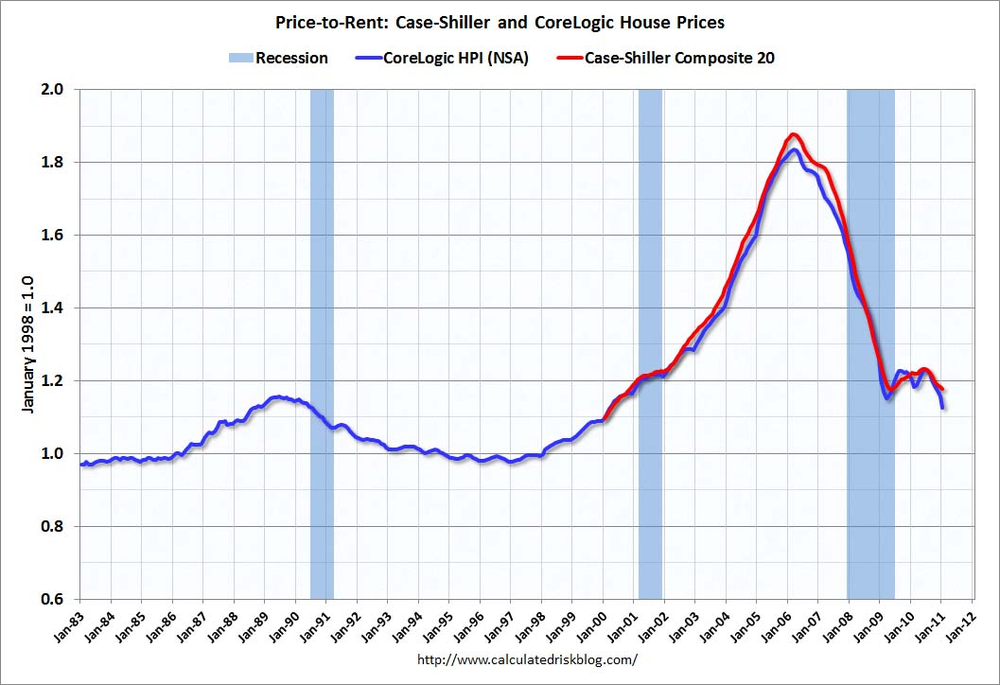
What Does a Housing Bubble Look Like?

Slide 6
Housing and credit? I don’t get it.
Remember, an increase in savings leads to a decrease in interest rates and an increase in investment.
Also, remember that residential housing is counted as part of gross private domestic investment when computing GDP.
Thus, an increase in savings was behind the housing bubble.
So where did this increase in savings come from?

Slide 7
Developing Countries and Savings
Developing countries often have savings rates that are far higher than developed economies, like the U.S.
Starting in the late 1990s, China and India (among other countries) experienced strong rates of economic growth, as high as 10% per year.
This is due to the early stages of industrialization in the two countries.
Because savings rate were so high in those countries, this rapid growth in output (and income), holding consumption roughly constant, lead to the rapid accumulation of savings.

Slide 8
The Global Pool of Savings
Between 2000 and 2004, the global pool of savings almost doubled in size, from roughly $36 trillion to around $70 trillion.
So where did this money go? At least some of it was invested in the U.S. housing market.
This increase in savings, due to rapid growth in developing economies, is one of the early factors that helped the twin bubbles.

Slide 9
But Why Housing?
Normally much of this increase in global savings would have been invested in U.S. Treasury securities.
Treasuries are very safe, very liquid, but typically don’t pay very high rates.
During the period of growth in global savings, interest rates on Treasuries were abnormally low, so the money found its way into housing.

Slide 10
Why Were Rates on Treasuries So Low?
The Recession of 2001
The target FFR fell from 6% to 1.75% in 2001 as the Fed attempted to stimulate the economy. It later fell to 1% in June 2003.
As the U.S. labor market began to improve in 2003 and 2004, the target FFR began to creep upward, starting in June 2004. By June 2006, it stood at 5.75%.
Because the Fed purchases short-term Treasuries in order to push down the actual FFR, this had the effect of keeping rates on all Treasuries low for several years in the early part of the decade.
So where did all that savings go? Housing.

Slide 11
So wait …
Were foreign savers buying tons of houses in the U.S. (and other countries)?
No. Foreign savers were buying mortgage-backed securities (MBSs).
Mortgage-backed securities were first issued in the late 1960s by the Government National Mortgage Association (GNMA, or Ginnie Mae)
Fannie Mae (the Federal National Mortgage Association) issued its first MBS in 1981; Freddie Mac (the Federal Home Loan Mortgage Corporation) issued its first MBS in 1971.

Slide 12
How Does a MBS Work?
One company, usually a bank, issues a bunch of mortgages. This company is known as the originator.
Some other company, sometimes Fannie Mae or her friends, buys those mortgages, bundles them together, and sells the income from the monthly mortgage payments. This company is known as an intermediary.
This is known as securitization; transforming an illiquid asset (i.e. a mortgage) into a liquid asset (i.e. a tradable security).

Slide 13
Securitization
Securitization has many benefits.
  Increasing liquidity in mortgage markets.
  Spreading risk.
  Increasing funds available for mortgages.
Many assets can be securitized.
As long as markets are efficient, securitization can improve the functioning of our financial system, by better matching savers and borrowers.

Slide 14
OK, I think I see …
Securitization helped overseas savers invest indirectly in the housing market by purchasing MBSs.
This allowed for the flow of funds from the global pool of savings into the U.S. housing market.
So why did the housing market develop a bubble? Isn’t securitization supposed to be a good thing?

Slide 15
Financial Market Deregulation
Yes, securitization can be good, but only if markets function efficiently.
There were many things that prevented credit markets (and the housing market) from operating efficiently.
Financial market deregulation was one of those things.

Slide 16
The Gramm-Leach-Bliley Financial Services Modernization Act of 1999
This law removed many firewalls (safety barriers) between banking, insurance, and finance.
These firewalls were put into place during the Great Depression to prevent problems in one sector of the financial services industry from harming the other sectors.
By the late 1990s, these firewalls were seen as out of date.

Slide 17
The Shadow Banking Industry
Gramm-Leach-Bliley allowed for growth in the shadow banking industry – firms that acted like banks but were not regulated like banks.
The shadow banking industry consisted of firms like Countrywide, a mortgage lender, as well as hedge funds, structured investment vehicles, and investment banks. These firms created or helped create ever larger numbers of mortgages, under ever lower lending standards, helping to fuel the housing bubble.
Many banks also created lots of mortgages, but banks are subject to capital requirements that mortgage lenders were not. These capital requirements create a cushion should one mortgage, or several, fail.

Slide 18
The Flow of Funds
Growth in the shadow banking industry helped ever more foreign savings flow into housing markets through the creation of MBSs, which were used to issue ever more mortgages.
Because these firms were not regulated like banks, there was less oversight in what mortgages were created.
Also, the MBSs themselves were very thinly regulated. They later became known as “toxic assets.”
Also, many banks borrowed heavily to invest in these “toxic assets.” This is called leveraging, and can be very destructive.
This helped lead to the subprime mortgage crisis.

Slide 19
Subprime Lending
Subprime mortgages are those issued to higher-risk borrowers.
These mortgages are often ARMs, adjustable rate mortgages. (In fact, 80% of subprime loans are ARMs.) ARMs feature low initial payments and a low interest rate for the first 3-5 years. Then the interest rate rises and “floats” with market interest rates. As a result, the monthly payment rises as well.
ARMs shift the risk of fluctuating interest rates from the lender onto the borrower, which is why borrowers are offered low rates and payments up front, as an incentive to take on more risk.
In 2006, 20% of all mortgages issued were subprime.
Between 2003 and 2007, the volume of subprime mortgages increased from $332 billion to $1.3 trillion (292%).

Slide 20
So ARMs are to blame, right?
Not really. ARMs have been around for decades, well before any housing bubble began.
The problem is that with ever more money flowing in the market for MBSs, and through them to the housing market, pressure was placed on originators to lower lending standards.
This allowed them to issue mortgages to people who otherwise would not have been able to borrow.
But, ARMs can be complicated and easily misunderstood by less-than-savvy borrowers.
Also, the low initial interest rate (often called a “teaser rate’) and low monthly payment can be exploited by unscrupulous lenders to dupe people into buying houses they can’t afford.
At the peak of the bubble, around 45% of Countrywide’s mortgage portfolio was subprime. In contrast, only around 5% of Fannie Mae’s portfolio was subprime.

Slide 21
Decline in Lending Standards
Typically households are asked for a lot of information before they can borrow to buy a house.
Credit score, outstanding debt, savings, proof of income.
This helps reduce risk to lenders.
At the peak of the bubble, lenders were issuing “liar loans,” where no information was sought other than credit score.
As long as your score was about 650 (not very high), you could borrow.
No questions about outstanding debt, savings, or even proof of income.
This didn’t happen overnight, but as more money flowed into the housing market, the pressure to create more mortgages grew. This caused lending standards to fall.

Slide 22
So wait …
You’re saying that mortgage lenders willingly loaned money to people who had no reasonable chance of repaying it?
Yep.
And you’re saying that these lenders willingly abandoned traditional standards of lending and deliberately chose to not ask for relevant information about a borrower’s ability to repay these loans?
Uh-huh.
And, you’re saying that borrowers actually bought into this charade? That people earning relatively meager salaries actually believed that they could afford to borrow hundreds of thousands of dollars to buy a house?
Yeppers.
And, you’re saying that lenders never even bothered to verify that many of these borrowers even had a job?
Sí señor.
So, what on Earth could have motivated these lenders to make such profoundly stupid decisions?
Well, a number of factors were involved. Among them …

Slide 23
PROFIT!!!
That is to say, profit
Plus more profit
Additional profit
Extra profit
Even more profit
Icing-on-the-cake profit
Summers-in-the-Hamptons profit
Ridiculous, obscene, stupid profit
Can-I-get-a-witness-as-to-how-absurd-this-profit-is profit?
I-want-Beyoncé-to-play-my-kid’s-birthday-party profit
Is-the-moon-for-sale-because-I-bet-it-has-a-wicked-view-of-Boston-harbor profit
Plus stupidity. Seriously people.

Slide 24
Let’s review …
An increase in foreign savings …
Coupled with low interest rates on Treasuries …
And financial market innovation in MBSs …
Plus financial industry deregulation …
Lead to the housing bubble, right?
Basically, yes.
But there was more …

Slide 25
[sigh] What else?
People aren’t always rational!
Yeah, no kidding. So what?
Many people in the U.S. suffered from two mass delusions. These two delusions helped fuel the growth of the housing bubble and prevented many from recognizing the bubble until it was too late.

Slide 26
The Two Mass Delusions
Markets are always efficient.
Housing prices will always rise.
So what’s the big deal?
Well, if markets are always efficient, then the price of financial assets are always priced “correctly,” i.e. based on economic fundamentals.
And, if housing prices always rise, then there can be no housing bubble, just a little “froth” in some markets.
This helped contribute to increased speculation in housing markets. During 2005, 28% of homes purchased were for “investment purposes;” another 12% were for vacation homes. (In 2006, those numbers were 22% and 14%, respectively.) Further, in Miami, as many as 85% of condo sales were speculative.

Slide 27
The Two Mass Delusions
The problem is that the risk associated with the MBSs was greatly underestimated.
Why? Super-complicated computer-based financial models predicted that default rates on the very riskiest mortgages (i.e. subprime mortgages) would be acceptably low, in the 5% range.
The actual rate of default on the riskiest mortgages ultimately climbed to as high as 50%.
Oops.
These super-complicated financial models were built on one basic assumption: that housing prices would never fall.
They ultimately did, by as much as 50% in some markets.
Oops again. Our bad.
Sadly, nearly everyone bought the hype, from lenders to borrowers to Wall St. to regulators. It was a failure of rational behavior as is rarely seen.

Slide 28
Let’s review …
An increase in foreign savings …
Coupled with low interest rates on Treasuries …
And financial market innovation in MBSs …
Plus financial industry deregulation …
And the widespread belief that markets are always efficient and that housing prices will always rise …
Lead to the housing bubble, right?
Basically, yes.
But there was more …

Slide 29
Two More Factors Came Into Play
Credit rating agencies and insurance companies
Credit rating agencies, like Standard & Poors, Moody’s, and Fitch perform a valuable function in financial markets. They examine companies that have issued stocks and bonds and determine their creditworthiness. This measures how likely are these companies to repay their debt.
Outstanding obligations (i.e. bonds) are assigned a grade based on the creditworthiness of the borrower (i.e. the company that issued the bonds).
Examples: Moody’s rates the lowest risk bonds as Aaa; then Aa1, Aa2, or Aa3 for companies with very low credit risk, but some susceptability to long-term risk; then A1, A2, A3; then Baa1, Baa2, Baa3; and so on.
Having an accurate and honest assessment of the level of risk embedded in bonds and other securities is essential for investors to make wise decisions about where to allocate funds.

Slide 30
The Credit Rating Agencies Failed on Two Fronts
They failed to appreciate the complexity of the MBSs issued by Wall Street investment banks which were fueling the housing bubble. Especially, they failed to see how all of this lending and borrowing was predicated on the assumption that housing prices would always rise.
They allowed Wall Street firms to “shop around” to get the best rating for their latest round of MBSs. If Fitch wouldn’t an investment bank a high enough score for its MBSs, the investment bank would go next door to Moody’s or Standard and Poor’s until it got the rating it wanted.
As a result, MBSs that were composed of subprime mortgages – very risky mortgages – and which should have received a low credit rating – much like a junk bond – instead were granted the very highest credit rating.
Magic! Next, we will spin straw into gold!!
Credit ratings basically became worthless, although no one knew it at the time.

Slide 31
Insurance Companies Didn’t Help
Normally, insurance companies play a very important role in our financial system and economy.
The allow individuals to reduce the risk of future events, like illness, loss of a job, car accidents, and death.
In order for insurance contracts to be priced correctly, insurance companies must have a near complete understanding of the likelihood of those future events occurring and of the financial cost those events represent.
Insurance companies sold credit default swaps (CDSs), a form of insurance, on MBSs. This allegedly protected investors in MBSs from the risk that the people who took out mortgages would default on their mortgages.
The insurance company AIG was heavily involved in this market. (remember that name …)
CDSs had been around since the early 1990s, but the use of them increased dramatically in 2003.
So what was the problem?

Slide 32
Ratings and CDSs
Inflated and inaccurate credit ratings gave a false sense of security to investors in MBSs. They made the securities seem a lot safer than they actually were. This encouraged Wall St. to make more MBSs and for more mortgages to be created.
Further, CDSs gave investors even more false security by providing insurance against losses in MBSs. Also, anyone could buy a CDS against a batch of MBSs, whether or not they ever actually bought those MBSs. This is like your neighbor buying fire insurance on your house. It introduced all sorts of distorted incentives and false security.
These failures had more to do with the flow of information than anything else.
Financial markets live and die based on information. Good information allows investors to make good decisions. Bad information encourages bad decisions.

Slide 33
So how did all of this break down? When did the bubble pop, and how did it infect the rest of the economy?
The trouble began in 2007. Remember, housing prices began to decline in mid-2006. This meant that many people would soon be making payments on a mortgage that was greater than the value of the home they lived in. This means that the house is underwater – it is worth less than the money borrowed to buy it.
Further, the ARMs issued 3-5 years ago would soon “reset” – the interest rate and monthly payment would increase – making it harder for borrowers to keep up with payments. This is especially difficult when the home is underwater, and is much more likely with subprime loans.

Slide 34
The Inevitable Slide into Recession
2007
  April: New Century Financial Corporation, a leading subprime lender, files for bankruptcy protection.
  June
    Standard & Poor’s and Moody’s begin downgrading securities backed by subprime mortgages.
    Bear Stearns, a Wall St. investment bank heavily involved in MBSs backed by subprime mortgages, suspends payments to investors in one of its investment funds.
    The FOMC votes to keep the target FFR constant at 5.25%.

Slide 35
The Inevitable Slide into Recession
2007
  July
    Standard & Poor’s places more MBSs on its watch list.
    Countrywide Financial warns of “difficult conditions.”
    Bear Stearns liquidates two hedge funds heavily invested in subprime MBSs.
  August
    American Home Mortgage Investment Corporation files for bankruptcy.
    The FOMC votes to keep the target FFR constant at 5.25%.
    The FRB announces an increase in willingness to supply reserves to the federal funds market and encourages firms to borrow from the discount window.
    Fitch downgrades Countrywide to its third lowest rating (BBB+); Countrywide borrows $11.5 billion from other banks.
    The FRB votes to lower the discount rate by 0.5% to 5.75% and open wider the discount window. It also releases a statement noting that the “downside risks to growth have increased appreciably.”

Slide 36
The Inevitable Slide into Recession
2007
  September
    The UK government agrees to provide liquidity support Northern Rock, the UK’s fifth largest mortgage lender.
    The FOMC votes to reduce the target FFR by 0.5% to 4.75%, and the discount rate by another 0.5% to 5.25%.
  October
    The U.S. Treasury Department creates the HOPE NOW program, a cooperative effort between the government, counselors, investors, and lenders, to help homeowners pay their mortgages.
    Bank of America and other large banks create an $80 billion fund to provide liquidity to commercial paper markets.
    The FOMC votes to reduce the target FFR by 0.25% to 4.50%, and the discount rate by 0.25% to 5.00%.

Slide 37
The Inevitable Slide into Recession
2007
  November
    The interbank lending market begins to contract.
  December
    The FOMC votes to reduce the target FFR by 0.25% to 4.25%, and the discount rate by 0.25% to 4.75%.
    The FRB announces the creation of a Term Auction Facility (TAF) to provide funds to depository institutions. The funds, $20 billion per auction, will be auctioned every two weeks as conditions warrant.
2008
  January
    Bank of American announces it will buy Countrywide Financial.

Slide 38
The Inevitable Slide into Recession
2008
  January
    The FOMC votes to decrease the target FFR twice in one month, ultimately slashing it to 3% by month’s end, and the discount rate to 3.5%.
  February
    President Bush signs the Economic Stimulus Act, which injects $152 billion into the economy through tax rebate checks of between $300 (individual) and $600 (married couple), plus $300 per dependent child.
    Northern Rock is taken over by the UK government.
  March
    The FRB expands the TAF, increasing the amount of funds auctioned to $50 billion and extending them for another six months.
    The FRB announces the Term Securities Lending Facility (TSLF), which will lend up to $200 billion of Treasury securities for up to 28 days.
    JP Morgan Chase buys Bear Stearns.
    The FRB creates to Primary Dealer Credit Facility, which extends credit to dealers in U.S. Treasury securities.
    The FOMC slashes the target FFR to 2.25% and the discount rate to 2.75%.
    The FRB assists in Chase’s purchase of Bear Stearns.

Slide 39
The Inevitable Slide into Recession
2008
  April
    The FOMC cuts the target FFR to 2% and the discount rate to 2.25%.
  May
    The FRB expands the TSLF auctions and increases the TAF auctions to $75 billion.
  June
    Everyone takes a nap.
  July
    IndyMac Bank fails.
    The FRB authorizes the NY Fed to lend to Fannie Mae and Freddie Mac, later increasing those loans. The government also limits trading of Fannie Mae and Freddie Mac stock.
    President Bush signs the Housing and Economic Recovery Act which authorizes the Treasury to purchase GSE obligations.
    The FRB further expands the TSLF and PCDF.

Slide 40
The Inevitable Slide into Recession
2008
  August
    Nothing much happens. But wait until September …

Slide 41
The Inevitable Slide into Recession
2008
  September
    Federal government takes over Fannie Mae and Freddie Mac.
    The FRB further expands the TSLF.
    Bank of America agrees to buy Merrill Lynch for $50 billion.
    Lehman Brothers fails, sending financial markets into a tailspin.
    The FRB lends $85 billion to AIG.
    The commercial paper market comes dangerously close to collapse.
    The Treasury Department announces the Supplementary Financing Program, to help the Fed prop up the financial system.
    The FRB creates the Asset-Backed Commercial Paper Money Market Mutual Fund Liquidity Facility to improve liquidity in the commercial paper market.
    Goldman Sachs and Morgan Stanley are reclassified as bank holding companies.
    The Emergency Economic Stabilization Act is announced and rejected by the House of Representatives. It is later passed in October. This law authorizes the Treasury to spend up to $700 billion to purchase toxic assets and inject capital into banks. This is more commonly known as the “bank bailout.”
    Citigroup agrees to buy Wachovia.
    Washington Mutual fails; JP Morgan Chase agrees to buy it.

Slide 42
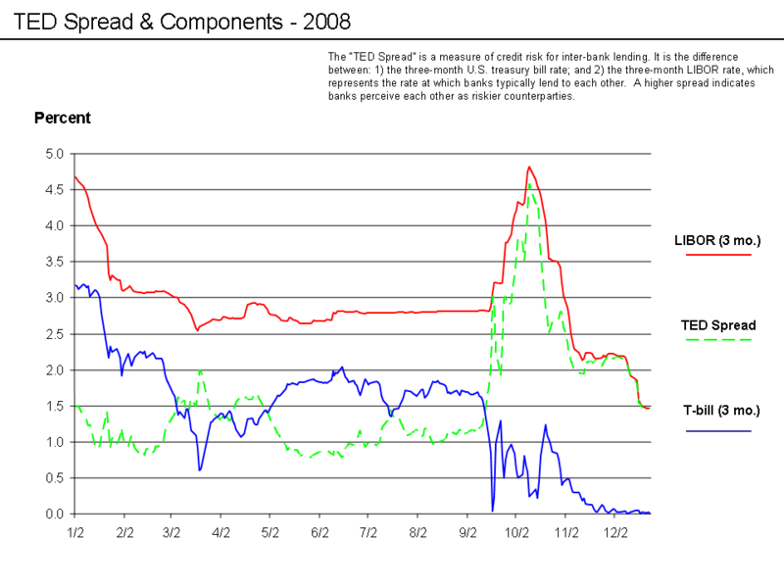
BTW, this is what panic looks like.

Slide 43
The Inevitable Slide into Recession
2008
  October
    The Emergency Economic Stabilization Act is passed. This establishes the $700 billion Troubled Asset Relief Program (TARP).
    The FRB creates the Commercial Paper Funding Facility, which provides liquidity to insurers of commercial paper.
    The FDIC increases deposit insurance to $250,000 per account per institution.
    The FRB lends another $37.8 billion to AIG.
    Wells Fargo makes a better offer for Wachovia; offer is approved.
    The FOMC lowers the target FFR to 1.50% and the discount rate to 1.75%.
    The FRB creates the Money Market Investor Funding Facility.
    The U.S. Treasury purchases $125 billion in preferred stock in nine U.S. banks.
    The FOMC lowers the target FFR to 1.00% and the discount rate to 1.25%.

Slide 44
The Inevitable Slide into Recession
2008
  November
    The FRB and Treasury reconfigure the financial support of AIG, by purchasing $40 billion of AIG shares and reducing loans to AIG from $65 billion to $40 billion.
    The Treasury purchases $33.5 billion in stock from 21 U.S. banks.
    Executives from Ford, Chrysler, and GM ask for money from the TARP. (GM ultimately got $13.4 billion; Chrysler $4 billion.)
    The FRB creates the Term Asset-Backed Securities Lending Facility (TALF), which does something. I can’t remember what. And frankly, all these acronyms are making my eyes hurt. So let’s summarize.

Slide 45
Who/What is to Blame?
While it is tempting to want to find a scapegoat in situations like this, it is important to remember that numerous factors lead to the crisis we’ve just discussed.
Thus, it would be overly reductive to try to blame the housing and credit bubbles, subprime mortgage crisis, financial market crisis, and subsequent recession on any one person, firm, or idea.
However, there is one person I think we can all agree is responsible …

Slide 46

Blake Griffin.

Slide 47

Blake Griffin.

Slide 48
The Culprits
The Giant Pool of Money.
    Because bubbles don’t inflate by themselves. All that liquidity had to come from somewhere.
The Two Mass Delusions.
    Because markets aren’t always efficient and yes, housing prices can fall, if we are in the midst of a bubble, which we clearly were.
Financial Market Deregulation.
    Because sometimes firewalls are a good thing. Also, sometimes financial innovation is a bad thing. Also, sometimes oversight is a good thing.
The Fed.
    For keeping interest rates so low in the 2000s, for encouraging financial market deregulation, and for failing to appreciate that we were in a bubble before it was too late.

Slide 49
You Want Names?
Alan Greenspan
    Fed Chair from 1987 to 2006.
    Instrumental in getting the financial industry deregulation bill passed.
    Fervent believer in market efficiency.
    Absolute brilliant in terms of controlling inflation in the 1990s.
    Not so brilliant at foreseeing bubbles.
    Later apologized for this.
More banking executives and lenders than I can name.
Irresponsible borrowers.
Lax regulators.

Slide 50
Questions?
I didn’t have a chance to compile my sources, so let me know if you are interested in some articles, podcasts, and books, and I’ll send them your way.

